Slide 1

Understanding the Home Tab in Microsoft Excel: Groups and Their Features
A breakdown of each group and its tools
Presented by [Your Name]
[Date]

Slide 2
Presentation Overview
Unlock Excel's Power: Master the Home Tab
1
2
Introduction to the Home Tab
Deep Dive into 7 Key Groups
Explore the foundational tab for everyday Excel tasks.
Understanding each section and its essential tools.
3
4
Practical Applications
Summary & Next Steps
Learn how to efficiently format, organize, and edit your data.
Recap key takeaways and continuous learning.

Slide 3
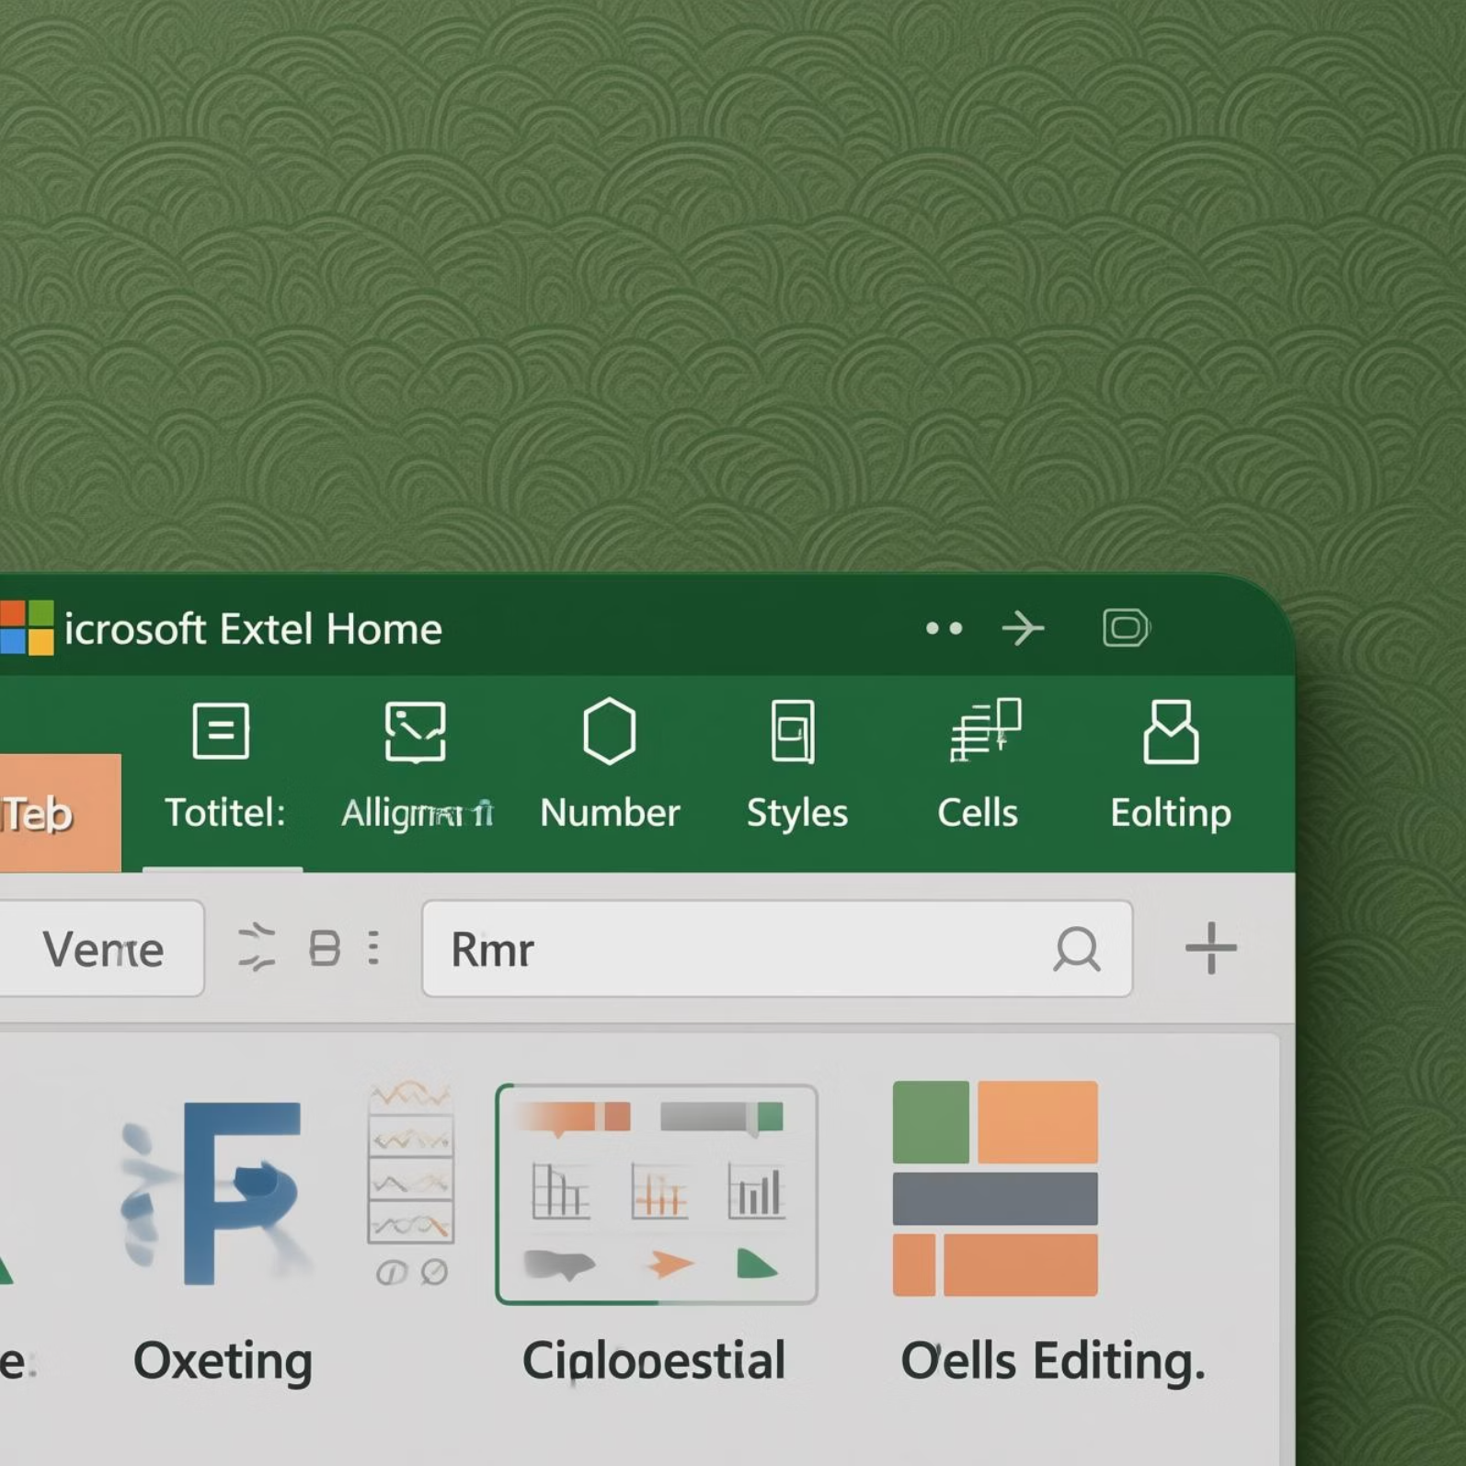
The Home Tab: Your Excel Command Centre
The Home tab is the most frequently used tab in Microsoft Excel, acting as your primary control panel for daily tasks. It houses a collection of essential tools designed to streamline your workflow and enhance data presentation.
From basic formatting to complex data manipulation, the Home tab makes common operations accessible and efficient. It is thoughtfully organised into seven distinct groups, each dedicated to a specific category of functions.

Slide 4

Clipboard Group: Copy, Cut & Paste with Precision
The Clipboard group provides fundamental tools for moving and duplicating data within and between your spreadsheets. These functions are indispensable for efficient data handling.
Cut (Ctrl+X): Removes selected content from its original location to the clipboard.
Copy (Ctrl+C): Duplicates selected content to the clipboard, leaving the original intact.
Paste (Ctrl+V): Inserts content from the clipboard into a new location. Includes various paste options like values, formulas, or formatting.
Format Painter: A powerful tool to copy the formatting from one cell or range and apply it to another, saving significant time on consistent styling.

Slide 5





Font Group: Beautify Your Data
The Font group is dedicated to customising the appearance of your text and numbers, making your data more readable and visually appealing.
Font Type & Size
Styles (B, I, U)
Fill Colour
Change the typeface (e.g., Calibri, Arial) and adjust the text size for readability or emphasis.
Apply bold, italics, or underline to highlight specific text or headings.
Apply background colours to cells to categorise or draw attention to data.
Font Colour
Borders
Change the colour of the text itself for visual contrast or branding.
Add lines around cells or ranges to create tables or visually separate data blocks.

Slide 6




Alignment Group: Organise Content Neatly
Ensure your data is presented clearly and professionally by controlling its position within cells.
Text Alignment
Merge & Centre
Position text horizontally (left, center, right) and vertically (top, middle, bottom) within cells.
Combine multiple cells into one large cell, often used for titles or headings spanning across columns.
Wrap Text
Orientation
Displays all content within a cell by wrapping text onto multiple lines if the column width is insufficient.
Change the direction of text, useful for narrow columns or creating unique layouts.

Slide 7
Number Group: Format Your Values Intuitively
The Number group allows you to display numeric values in a variety of formats, making complex data immediately understandable.
General
Currency/Accounting
The default format, suitable for most data types.
Displays numbers as monetary values with currency symbols and decimal places.
Percentage
Date/Time
Multiplies by 100 and adds a percentage sign (e.g., 0.5 becomes 50%).
Formats numbers as dates or times according to various regional settings.
Comma Style
Increase/Decrease Decimal
Adds a thousand separator and two decimal places for larger numbers.
Adds or removes decimal places without changing the underlying value.

Slide 8
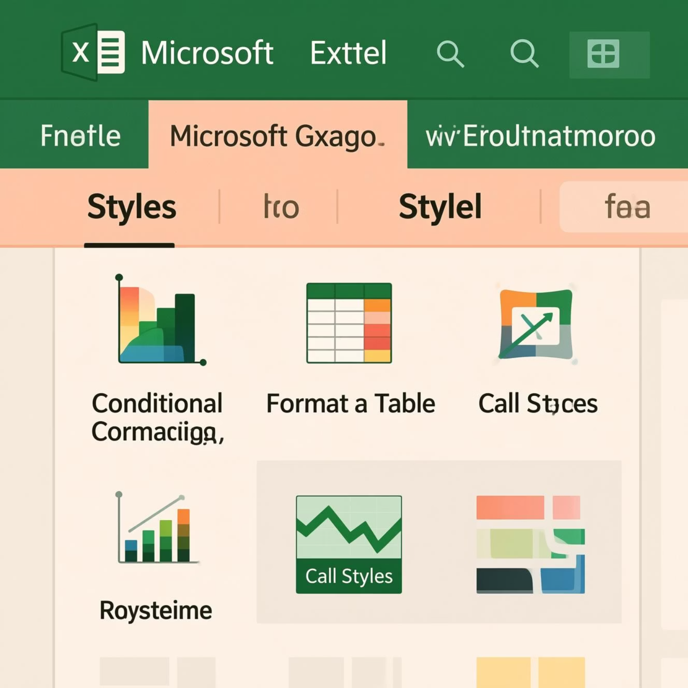
Styles Group: Apply Visual Polish
The Styles group provides powerful tools to apply quick, professional formatting and visual rules to your data, saving time and ensuring consistency.
Conditional Formatting: Automatically applies formatting (e.g., colours, icons) to cells based on specified conditions, helping to visualise trends or outliers.
Format as Table: Converts a range of data into an Excel Table, which comes with built-in styling, filtering, and sorting capabilities.
Cell Styles: Pre-defined or customisable sets of formatting attributes (font, colour, borders, number format) that can be applied to cells for quick, consistent styling.

Slide 9
Cells & Editing Groups: Structure & Manipulate
Cells Group: Modify Layout
Editing Group: Data Management
This group allows you to alter the structure of your worksheet by adding, removing, or adjusting cells, rows, and columns.
Contains tools for quick calculations, data filling, clearing, sorting, filtering, and finding specific information.
AutoSum: Quickly calculates sums, averages, counts, etc.
Insert: Adds new cells, rows, columns, or entire sheets.
Delete: Removes selected cells, rows, columns, or sheets.
Fill: Automatically fills data into adjacent cells based on a pattern.
Format: Adjusts row height, column width, hides/unhides, renames sheets, and protects cells.
Clear: Removes all or specific aspects (formats, content) from selected cells.
Sort & Filter: Organises data alphabetically, numerically, or by specific criteria.
Find & Select: Locates specific content or objects within your worksheet.

Slide 10
Summary: Master Your Home Tab
1
The Power of Organisation
2
Foundational for All Users
3
Continuous Efficiency
Regular practice with these tools will significantly enhance your productivity and confidence in managing any spreadsheet task.
The Home tab is designed for efficiency, consolidating the most common Excel functions into seven logical groups: Clipboard, Font, Alignment, Number, Styles, Cells, and Editing.
Whether you're a beginner or an experienced user, mastering these groups is crucial for effective data entry, formatting, analysis, and presentation.
Thank you! Now, go forth and Excel!

